Slide 1
Default Parameters

Slide 2
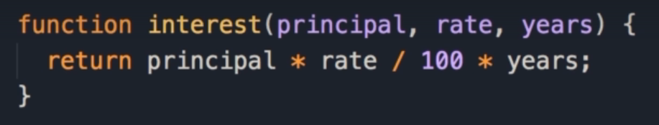
Scenario
There are times that we want to supply default values to the parameters of a function.
Here we have a function for calculating interest:
The function takes 3 parameters, principal (amount), interest rate and years.
The formula to calculate total interest is principal * rate / 100 * years
Notes:
There are times that we want to supply default values to the parameters of a function.
For example, let's imagine we want to write a function for calculating the total interest.
So here we have there parameters, principle, interest rate and years.
And here's the formula, to calculate the total interest.
Principle times rate divided by 100 times years.

Slide 3
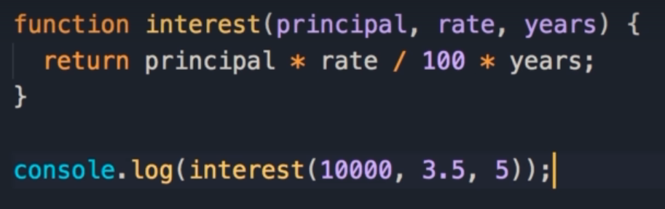

Calculating interest
When we call the function, we pass in 10000 for the principal, 3.5 as the interest rate, and we are paying this back over 5 years.
In our console, we see that the total interest we have to pay back is 1750.
Notes:
Now, let's call this function, let's imagine the principle is 10,000 dollars rate is 3.5 percent, and we want to pay this back over 5 years.
So let's log this on the console, so the total interest we have to pay is just over 1700.

Slide 4
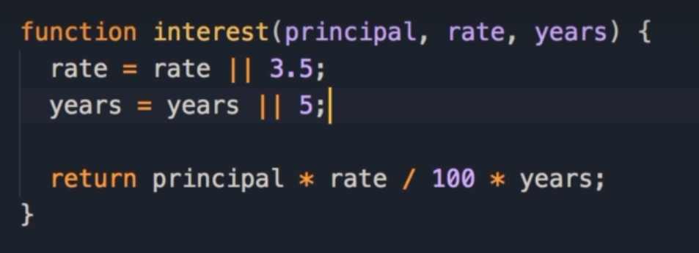

Default values
Here we supply default values for interest rate and number of years.
In the section about operators, we learnt about the technique using OR (||)
rate = rate || 3.5;
So if rate has a truthy value, use that, else use 3.5
We can use the logical or operator to give variables a default value.
With this, if we exclude these arguments, those default values will be used.
Notes:
Now, what if we want to have default values for an interest rate and the number of years.
Well, earlier in this section about operators, I showed you a technique like this.
So rate equals rate or 3.5.
So if rate has a value, if it's truthy, we're going to use that, otherwise we're going to use 3.5.
So we can use the logical or operator to get a variable a default value, similarly we can set years, years or 5.
With this, if we exclude these arguments, those default values will be used.
So I'm going to delete these, save the changes, and see we still get the same result.

Slide 5
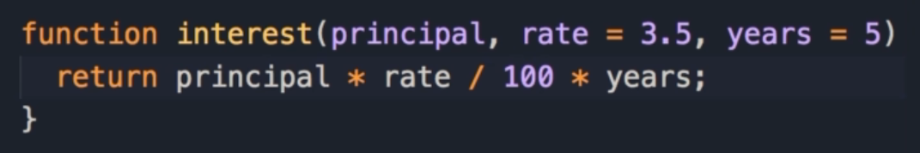
Easier Default Parameters
Starting from ES6, we have a cleaner and easier way to do this, by setting the default values when declaring the parameters themselves.
So we set rate to 3.5 and years to 5
The results in our log show the total interest correctly.
As you can see, setting default parameters is easy.
Notes:
But starting from ES6, we have a cleaner way to actually have the same thing.
So instead of having these logical expressions, we can set the default values right here.
So, we set to rate to 3.5, and years to 5.
And now we can delete these two lines, save the changes, you still get the same result, So we can see that setting the default value for function parameters is really easy.

Slide 6
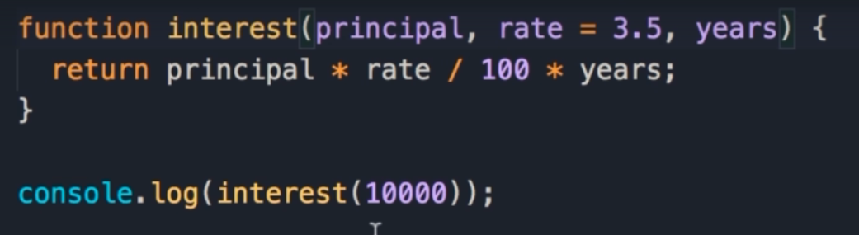

Default Value conventions
One convention that you must follow, is that once you give a parameter a default value, you should also give all the other parameters after that a default value.
Here we set the default value for rate, but not for years.
When we log this, we get Not a Number, because we pass 10,000, so principal is 10,000, rate is by default 3.5, but years doesn't have a value, so it's undefined.
That’s why the result is Not a Number
Notes:
There is just one caveat here, once you give a parameter a default value, you should also give all the other parameters after that a default value.
For example, let's see what happens if we set the default value for rate, but not years.
When we save the changes, we get not a number, because we past 10,000, so principle is 10,000, rate is by default 3.5 But years doesn't have a value, so it's undefined.
That's why the result of this expression is not a number.

Slide 7
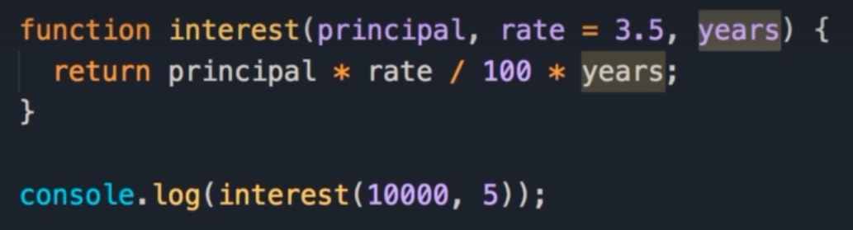
Default Value Confusion
Here we attempt to pass 5 for the years.
This is confusing for the JavaScript engine because it doesn't know if 5 should be used for rate or the years.
In our console we get the same result: Not a Number.
This is because in this case 5 is used for the rate, but years is still undefined.
Notes:
Now what if we passed 5 for the years?
Well this is confusing for the JavaScript engine because it doesn't know if 5 should be used for rate or the years.
So if I save the changes, you still get the same result, not a number.
Because in this case 5 is used for the rate, but years is still undefined.

Slide 8
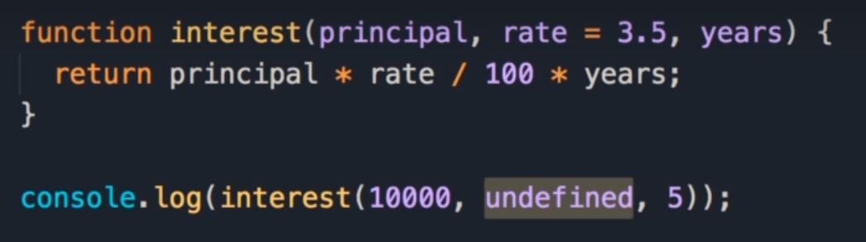
Passing undefined
There is a trick around this, we can pass undefined for the second parameter, and with this, rate will be set to 3.5 and years will be set to 5.
Now our console shows we get the same answer.
But code like this is really ugly.
Somebody looking at this code, they wonder, what is this undefined?
They have to look at the function to figure out what parameter is associated with undefined.
So as a best practice, whenever you want to give the function parameter a default value, make sure that that parameter is the last parameter in the list, or give all the parameters after that a default value.
Notes:
Now there is a trick around this, so, we can pass undefined for the second parameter, and with this, rate will be set to 3.5 and years will be set to 5, now we get the same result as before.
But code like this is really ugly.
Somebody looking at this code, they wonder, what is this undefined?
They have to look at the function to figure out what parameter is associated with undefined?
So as a best practice, whenever you want to give the function parameter a default value, make sure that that parameter is the last parameter in the list, or give all the parameters after that a default value.

